Slide 1
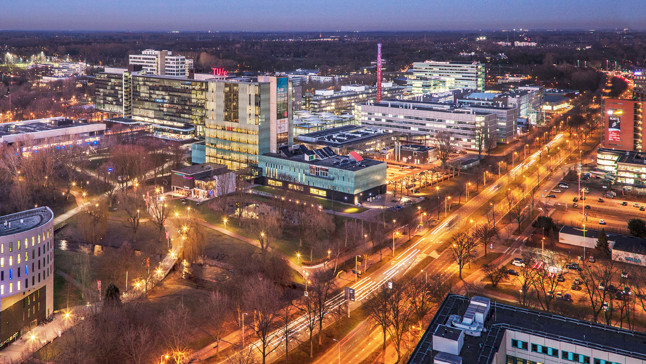
Structure Learning in High-Dimensional Time Series Data
Final project Presentation, 14-07-2022
Martin de Quincey
Mathematics and Computer Science

Slide 2
Outline
Problem Setting
Methodologies
Conclusion

Slide 3
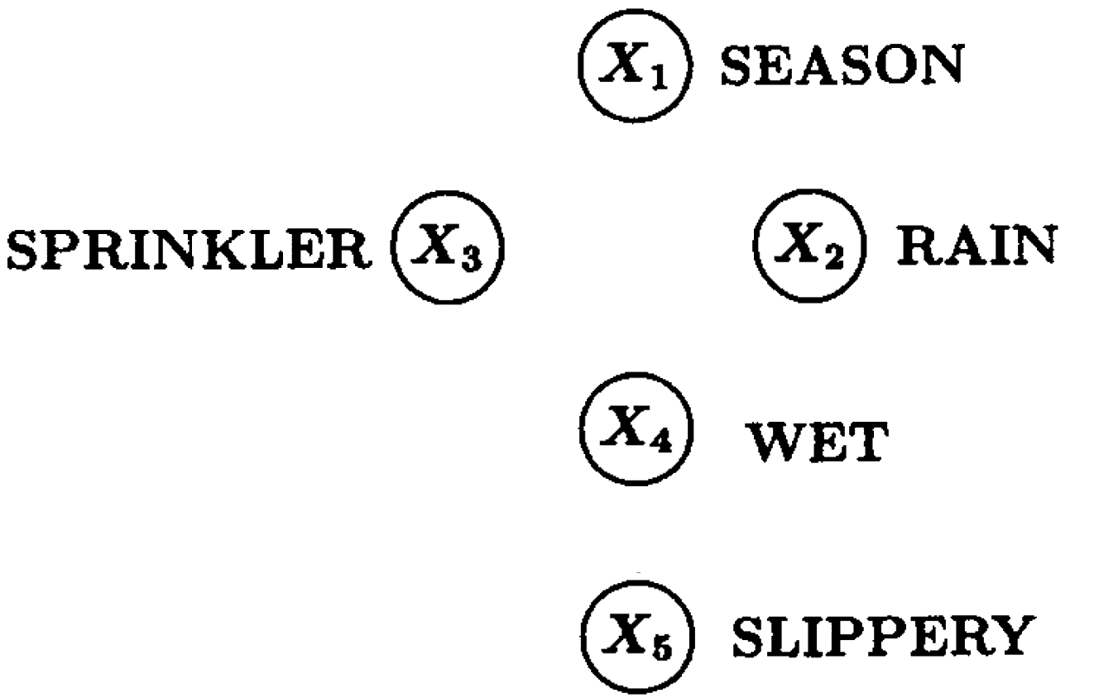



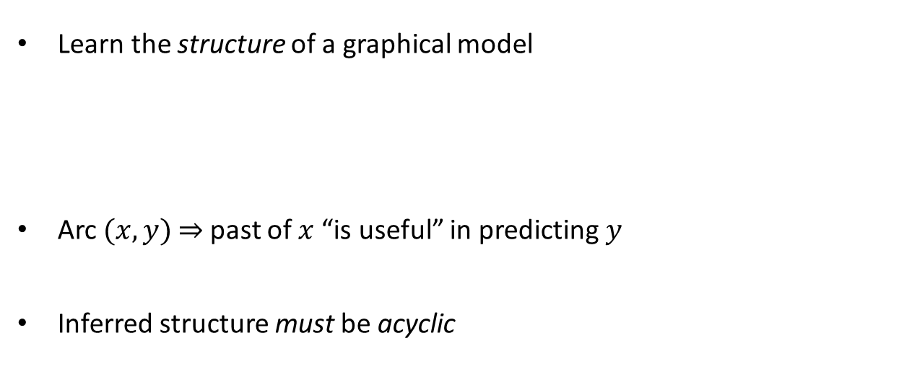
Introduction – Example [1]
Learn the structure of a graphical model
Arc $(x, y)$ $⇒$ past of $x$ “is useful” in predicting $y$
Inferred structure must be acyclic

Slide 4
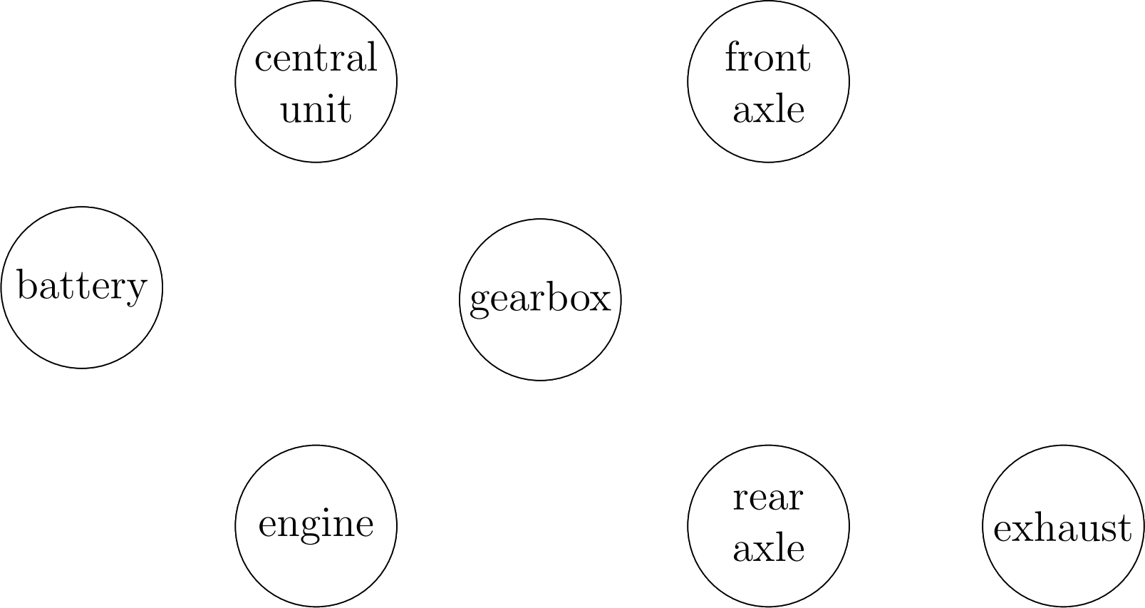
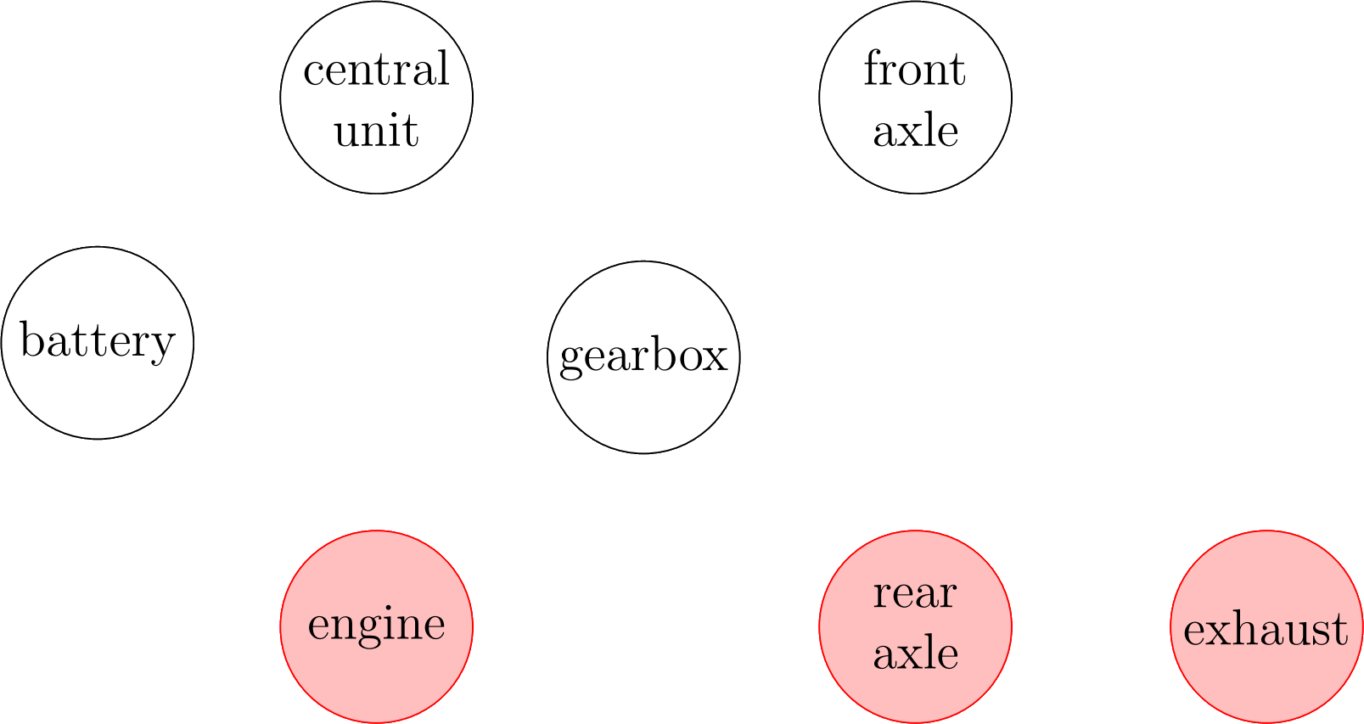
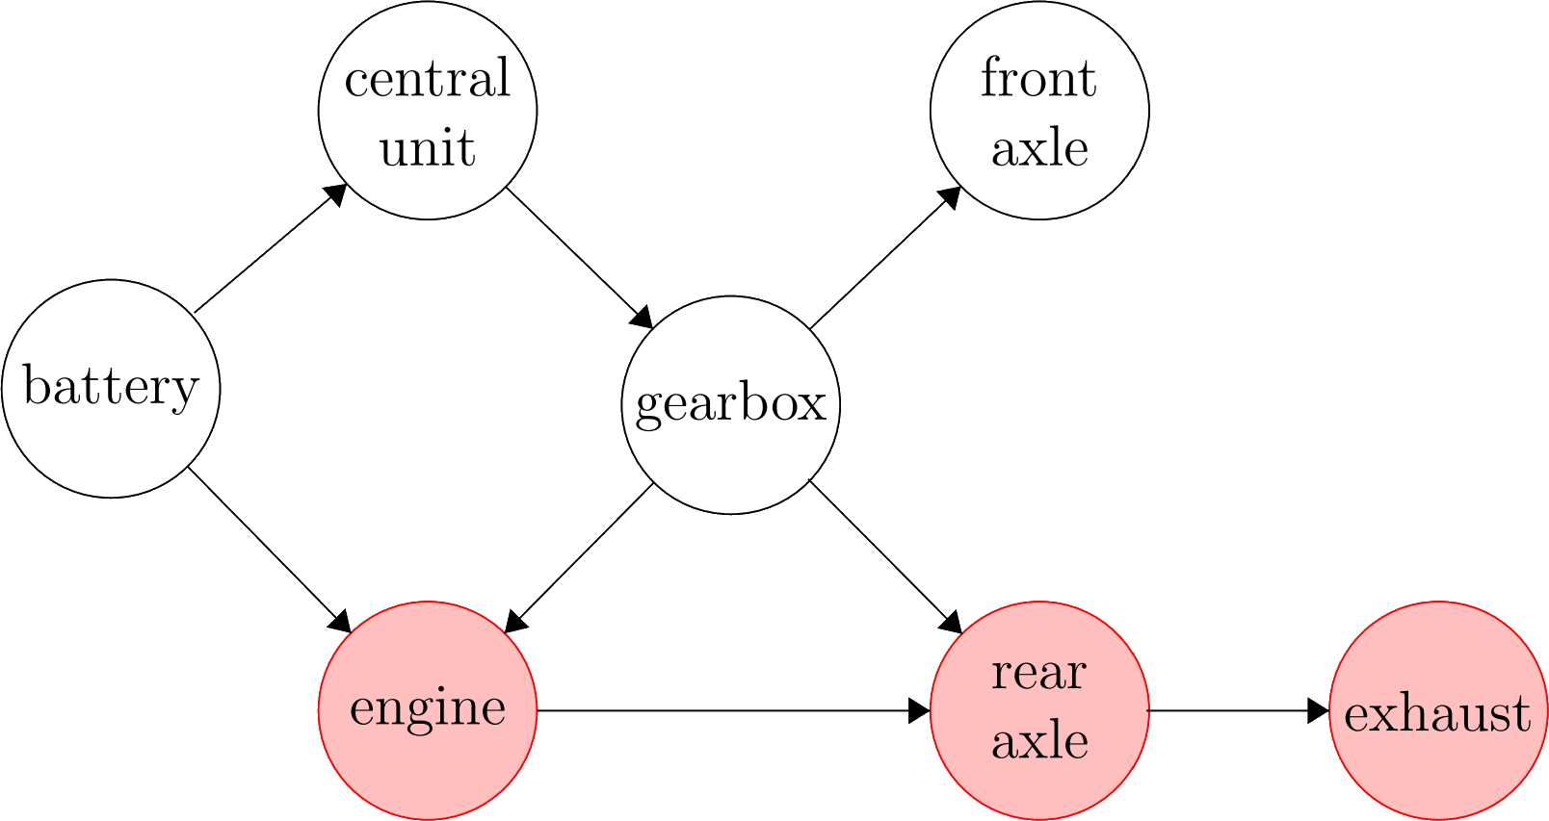
Motivation – Root Cause Analysis in a Car

Slide 5
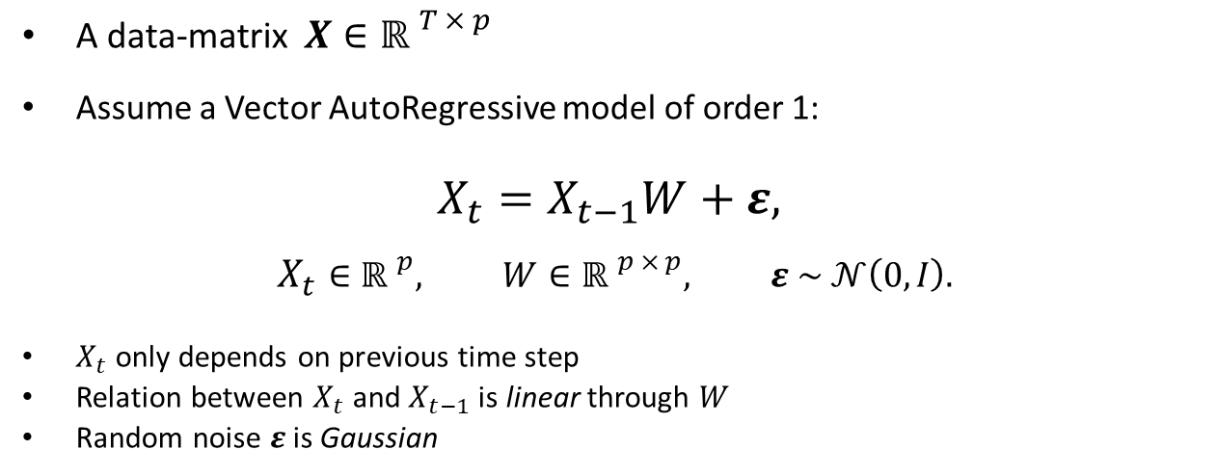
Formal Problem Setting
A data-matrix $X∈{ℝ }^{T × p}$
Assume a Vector AutoRegressive model of order 1:
$$X_{t}=X_{t−1}W+ε,$$
$$X_{t}∈{ℝ }^{p}, W∈{ℝ }^{p × p}, ε \sim 𝒩\left(0, I\right).$$
$X_{t}$ only depends on previous time step
Relation between $X_{t}$ and $X_{t−1}$ is linear through $W$
Random noise $ε$is Gaussian

Slide 6
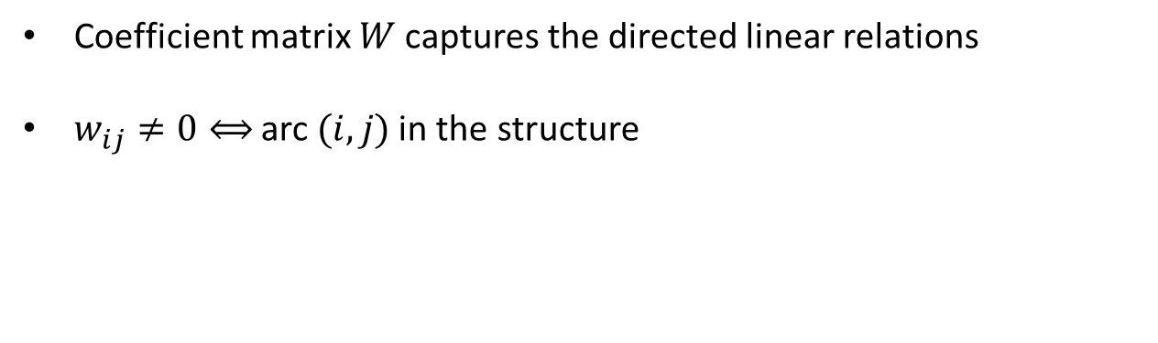
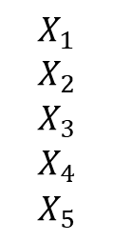
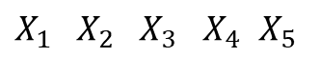
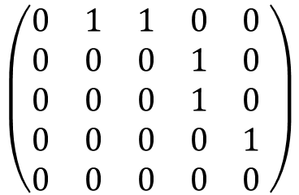
Formal Problem Setting
Coefficient matrix $W$captures the directed linear relations
$w_{ij}≠0⟺$ arc $(i, j)$in the structure
$X_{1}{ X}_{2}$ ${ X}_{3}$ $X_{4}$ $X_{5}$
$$X_{1}$$
$$X_{2}$$
$$X_{3}$$
$$X_{4}$$
$$X_{5}$$
$$\left(\begin{matrix}0 & 1 & 1 & 0 & 0 \\ 0 & 0 & 0 & 1 & 0 \\ 0 & 0 & 0 & 1 & 0 \\ 0 & 0 & 0 & 0 & 1 \\ 0 & 0 & 0 & 0 & 0\end{matrix} \right)$$

Slide 7
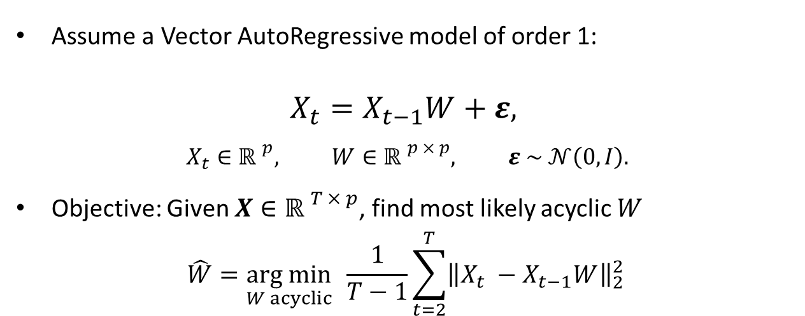
Formal Problem Setting
Assume a Vector AutoRegressive model of order 1:
$$X_{t}=X_{t−1}W+ε,$$
$$X_{t}∈{ℝ }^{p}, W∈{ℝ }^{p × p}, ε \sim 𝒩\left(0, I\right).$$
Objective: Given $X∈{ℝ }^{T × p}$, find most likely acyclic $W$
$$\hat{W}=\underset{W acyclic}{arg min}{ \frac{1}{T−1}\sum_{t=2}^{T}{{\left\|X_{t} −X_{t−1}W\right\|}_{2}^{2}}}{ }$$

Slide 8
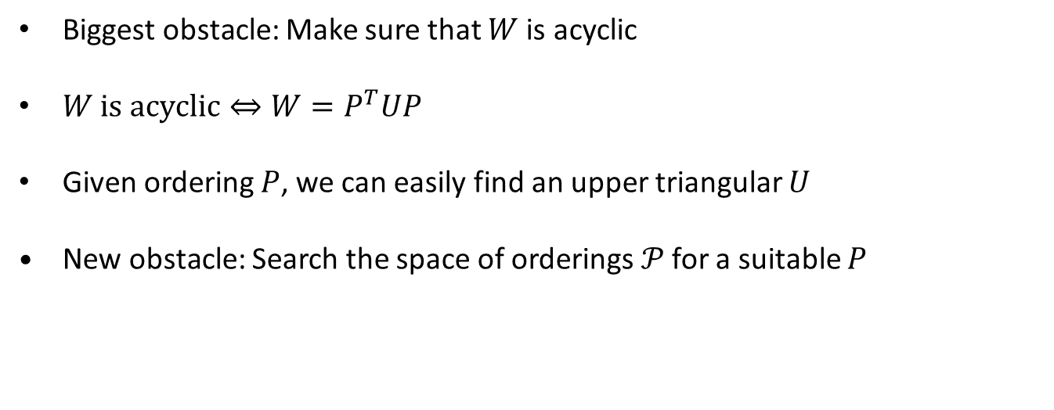
Orderings
Biggest obstacle: Make sure that $W$ is acyclic
$W \text{is} \text{a}cyclic⇔{W=P}^{T}UP$
Given ordering $P$, we can easily find an upper triangular $U$
New obstacle: Search the space of orderings$𝒫$ for a suitable $P$

Slide 9
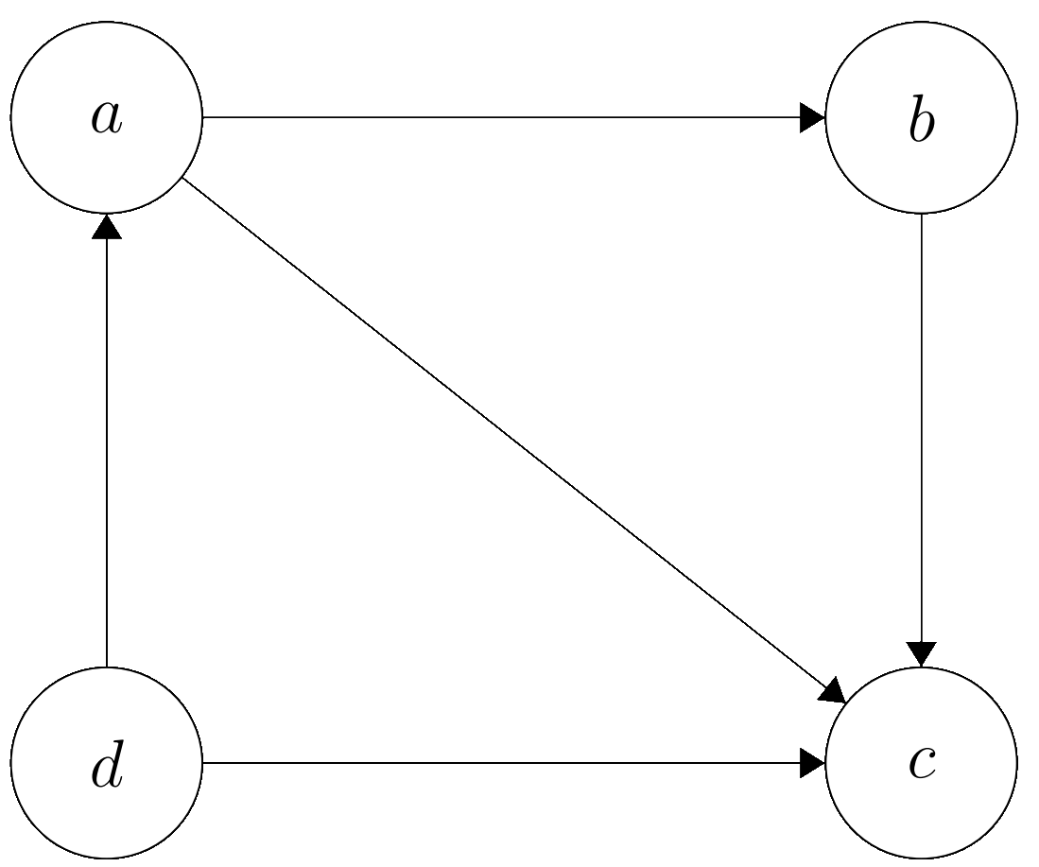
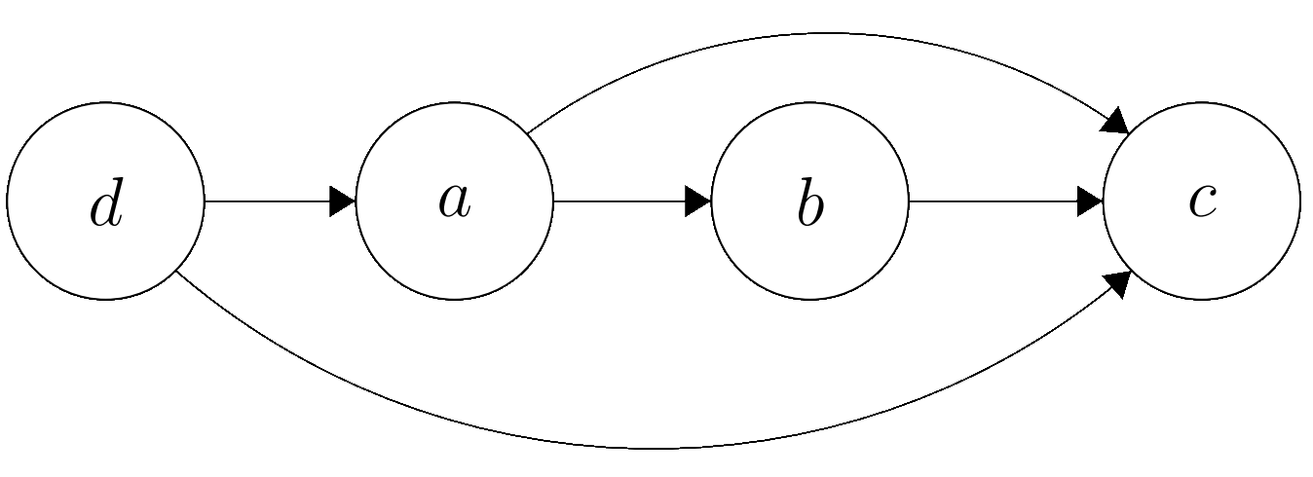
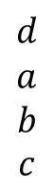
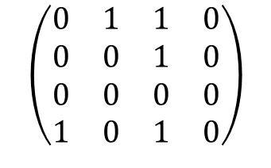
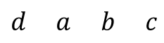
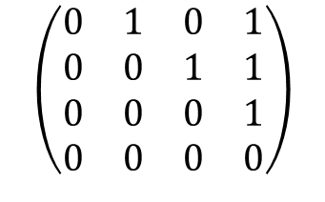
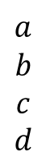
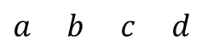
Orderings
$$a b c d$$
$$a$$
$$b$$
$$c$$
$$d$$
$$\left(\begin{matrix}0 & 1 & 1 & 0 \\ 0 & 0 & 1 & 0 \\ 0 & 0 & 0 & 0 \\ 1 & 0 & 1 & 0\end{matrix}\right)$$
$$d a b c$$
$$d$$
$$a$$
$$b$$
$$c$$
$$\left(\begin{matrix}0 & 1 & 0 & 1 \\ 0 & 0 & 1 & 1 \\ 0 & 0 & 0 & 1 \\ 0 & 0 & 0 & 0\end{matrix}\right)$$

Slide 10
Methodologies
Permutation-Based
Greedy Random Walk
Iterative
Orthogonal Matching Pursuit
Continuous
NOTEARS

Slide 11
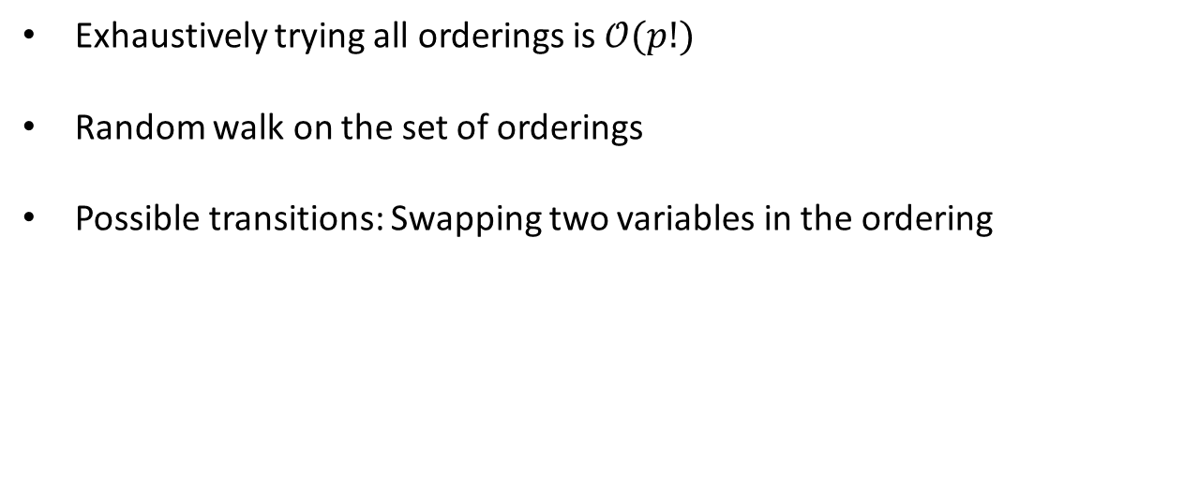
1) Random Walk
Exhaustively trying all orderings is $𝒪(p!)$
Random walk on the set of orderings
Possible transitions: Swapping two variables in the ordering

Slide 12
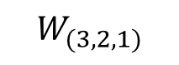
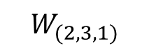
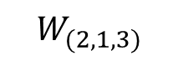
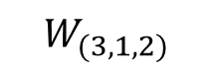
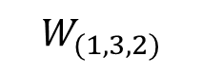
1) Random Walk
$$W_{(2, 1, 3)}$$
$$W_{(2, 3, 1)}$$
$$W_{(1, 2, 3)}$$
$$W_{(3, 2, 1)}$$
$$W_{(1, 3, 2)}$$
$$W_{(3, 1, 2)}$$

Slide 13
1) Greedy Random Walk
Randomly swap the order of two variables
Transition to this new ordering if it achieves a better score
Iterate until time-out

Slide 14
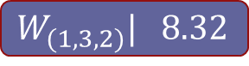
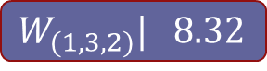
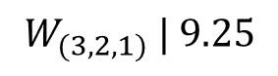
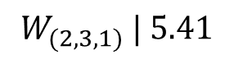
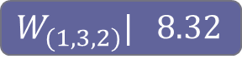
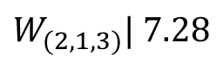
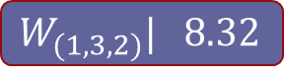
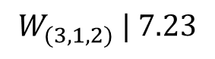

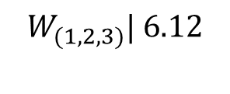

1) Greedy Random Walk
$$W_{(1, 3, 2)}| 8.32$$
$$W_{(1, 3, 2)}| 8.32$$
$$W_{(2, 1, 3)}| 7.28$$
$$W_{(2, 3, 1)} | 5.41$$
$$W_{(1, 3, 2)}| 8.32$$
$$W_{(1, 3, 2)}| 8.32$$
$$W_{(1, 2, 3)}\text{| }\text{6}\text{.12}$$
$$W_{(3, 2, 1)} | 9.25$$
$$W_{(3, 1, 2)} | 7.23$$
$$W_{(1, 3, 2)}| 8.32$$
$$W_{(1, 3, 2)}| 8.32$$

Slide 15
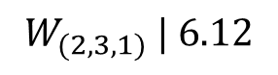
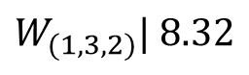
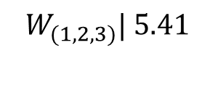
1) Greedy Random Walk
$$W_{(2, 1, 3)}| 7.28$$
$$W_{(2, 3, 1)} | 6.12$$
$$W_{(1, 2, 3)}\text{| }\text{5}\text{.}\text{4}\text{1}$$
$$W_{(3, 2, 1)} | 9.25$$
$$W_{(1, 3, 2)}| 8.32$$
$$W_{(3, 1, 2)} | 7.23$$

Slide 16
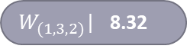
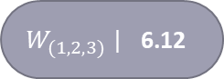
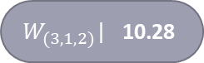
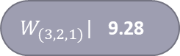
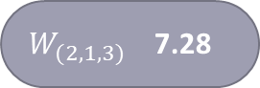
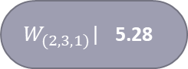
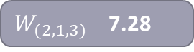
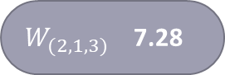

1) Greedy Random Walk
$W_{(2, 1, 3)}$ 7.28
$W_{(2, 3, 1)}$| 5.28
$W_{(2, 1, 3)}$ 7.28
$W_{(1, 2, 3)}$ | 6.12
$W_{(3, 2, 1)}$| 9.28
$W_{(2, 1, 3)}$ 7.28
$W_{(2, 1, 3)}$ 7.28
$W_{(3, 1, 2)}$| 10.28
$W_{(1, 3, 2)}$| 8.32

Slide 17
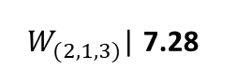
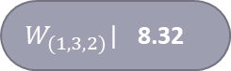
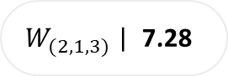

1) Greedy Random Walk
$W_{(2, 1, 3)}$ | 7.28
$W_{(2, 1, 3)}$| 7.28
$W_{(1, 2, 3)}$ | 6.12
$W_{(3, 2, 1)}$| 9.28
$W_{(2, 1, 3)}$ 7.28
$W_{(2, 1, 3)}$ 7.28
$W_{(1, 3, 2)}$| 8.32
$W_{(3, 1, 2)}$| 10.28

Slide 18

1) Greedy Random Walk
$W_{(2, 1, 3)}$ 7.28
$W_{(2, 3, 1)}$| 5.28
$W_{(1, 2, 3)}$ | 6.12
$W_{(3, 2, 1)}$| 9.28
$W_{(1, 3, 2)}$| 8.32
$W_{(3, 1, 2)}$| 10.28

Slide 19








1) Greedy Random Walk
$∎$: estimated ($≠0$) $∎$: not estimated ($=0$)
Ordering $(1, 2, 3).$
Try $(1, 3, 2)$
Try $(2, 1, 3)$
Try $(2, 3, 1)$
Try $(3, 2, 1)$
No improvements found.
$$\left(\begin{matrix}∎ & ∎ & ∎ \\ ∎ & ∎ & ∎ \\ ∎ & ∎ & ∎\end{matrix}\right)$$
$⟹$no improvement.
$⟹$ improvement.
$⟹$ no improvement.
$⟹$ improvement.
$$\left(\begin{matrix}∎ & ∎ & ∎ \\ ∎ & ∎ & ∎ \\ ∎ & ∎ & ∎\end{matrix}\right)$$
$$\left(\begin{matrix}∎ & ∎ & ∎ \\ ∎ & ∎ & ∎ \\ ∎ & ∎ & ∎\end{matrix}\right)$$
$$\left(\begin{matrix}∎ & ∎ & ∎ \\ ∎ & ∎ & ∎ \\ ∎ & ∎ & ∎\end{matrix}\right)$$
$$\left(\begin{matrix}∎ & ∎ & ∎ \\ ∎ & ∎ & ∎ \\ ∎ & ∎ & ∎\end{matrix}\right)$$

Slide 20

2) Orthogonal Matching Pursuit
Start with an empty matrix $W$
Add the arc $(i, j)$yielding the largest correlation with the current residuals:
$$\left(i, j\right)=\underset{(i, j)}{arg max}{\frac{\left|\left\langle X_{i}, r_{j}\right\rangle \right|}{\left\|X_{i}\right\|∙\left\|r_{j}\right\|}}.$$
Re-estimate residuals $r_{j}$
If this arc creates a cycle, exclude it and continue
Continue until stopping criterion

Slide 21



























2) Orthogonal Matching Pursuit
$$W=\left(\begin{matrix}0.82 & 0.63 & 4.77 \\ 0.00 & 0.84 & 0.24 \\ 0.00 & 0.00 & 0.68\end{matrix}\right)$$
$$W=\left(\begin{matrix}0.82 & 0.63 & 4.77 \\ 0.00 & 0.84 & 0.24 \\ 0.00 & 0.00 & 0.68\end{matrix}\right)$$
$$W=\left(\begin{matrix}0.82 & 0.63 & 4.77 \\ 0.00 & 0.84 & 0.24 \\ 0.00 & 0.00 & 0.68\end{matrix}\right)$$
$$W=\left(\begin{matrix}0.82 & 0.63 & 0.53 \\ 0.00 & 0.84 & 0.26 \\ 0.00 & 0.00 & 0.70\end{matrix}\right)$$
$$W=\left(\begin{matrix}0.00 & 0.00 & 0.00 \\ 0.00 & 0.00 & 0.00 \\ 0.00 & 0.00 & 0.00\end{matrix}\right)$$
$$W=\left(\begin{matrix}0.82 & 3.32 & 4.77 \\ 0.00 & 0.00 & 0.00 \\ 0.00 & 0.00 & 0.72\end{matrix}\right)$$
$$W=\left(\begin{matrix}0.82 & 3.32 & 4.77 \\ 0.00 & 0.00 & 0.00 \\ 0.00 & 0.00 & 0.72\end{matrix}\right)$$
$$W=\left(\begin{matrix}0.82 & 3.32 & 4.77 \\ 0.00 & 0.78 & 0.00 \\ 0.00 & 0.00 & 0.72\end{matrix}\right)$$
$$W=\left(\begin{matrix}0.82 & 0.63 & 4.77 \\ 0.00 & 0.84 & 0.00 \\ 0.00 & 0.00 & 0.72\end{matrix}\right)$$
$$W=\left(\begin{matrix}0.82 & 0.63 & 4.77 \\ 0.00 & 0.84 & 0.00 \\ 0.00 & 0.00 & 0.72\end{matrix}\right)$$
$$C=\left(\begin{matrix}8.67 & 2.32 & 0.94 \\ 2.65 & 6.65 & 1.65 \\ 0.82 & 0.42 & 7.94\end{matrix}\right)$$
$$C=\left(\begin{matrix}8.67 & 2.32 & 0.14 \\ 2.65 & 6.65 & \\ 0.82 & 0.42 & 7.94\end{matrix}\right)$$
$$C=\left(\begin{matrix}8.67 & 2.32 & 0.14 \\ 2.65 & 6.65 & \\ 0.82 & 0.42 & 7.94\end{matrix}\right)$$
$$C=\left(\begin{matrix}8.67 & 2.32 & 0.14 \\ 2.65 & 6.65 & \\ 0.82 & 0.42 & 7.94\end{matrix}\right)$$
$$C=\left(\begin{matrix}8.67 & 2.32 & \\ 2.65 & 6.65 & \\ & & 7.94\end{matrix}\right)$$
$$C=\left(\begin{matrix}8.67 & 3.32 & 4.77 \\ 2.12 & 6.65 & 1.12 \\ 3.14 & 0.32 & 7.94\end{matrix}\right)$$
$$C=\left(\begin{matrix}8.67 & 3.32 & 4.77 \\ 2.15 & 6.65 & 1.12 \\ 1.12 & 0.32 & 7.94\end{matrix}\right)$$
$$C=\left(\begin{matrix}8.67 & 3.32 & 0.94 \\ 2.15 & 6.65 & 1.65 \\ 1.12 & 0.32 & 7.94\end{matrix}\right)$$
$$C=\left(\begin{matrix}8.67 & 2.17 & 0.94 \\ 2.15 & 6.65 & 1.65 \\ 1.12 & 0.48 & 7.94\end{matrix}\right)$$
$$C=\left(\begin{matrix}8.67 & 2.32 & 0.94 \\ 2.15 & 6.65 & 1.65 \\ 1.12 & 0.42 & 7.94\end{matrix}\right)$$

Slide 22









2) Orthogonal Matching Pursuit
1 4 9
5 2 6
7 8 3
1 4 9
5 2 6
7 8 3
1 4 9
5 2 6
7 8 3
1 4 9
5 2 6
7 8 3
1 4 9
5 2 6
7 8 3
1 4 9
5 2 6
7 8 3
1 4 9
5 2 6
7 8 3
1 4 6
5 2 5
7 8 3
$$\left(\begin{matrix}∎ & ∎ & ∎ \\ ∎ & ∎ & ∎ \\ ∎ & ∎ & ∎\end{matrix}\right)$$
$$\left(\begin{matrix}∎ & ∎ & ∎ \\ ∎ & ∎ & ∎ \\ ∎ & ∎ & ∎\end{matrix}\right)$$
$$\left(\begin{matrix}∎ & ∎ & ∎ \\ ∎ & ∎ & ∎ \\ ∎ & ∎ & ∎\end{matrix}\right)$$
$$\left(\begin{matrix}∎ & ∎ & ∎ \\ ∎ & ∎ & ∎ \\ ∎ & ∎ & ∎\end{matrix}\right)$$
$$\left(\begin{matrix}∎ & ∎ & ∎ \\ ∎ & ∎ & ∎ \\ ∎ & ∎ & ∎\end{matrix}\right)$$
$$\left(\begin{matrix}∎ & ∎ & ∎ \\ ∎ & ∎ & ∎ \\ ∎ & ∎ & ∎\end{matrix}\right)$$
$$\left(\begin{matrix}∎ & ∎ & ∎ \\ ∎ & ∎ & ∎ \\ ∎ & ∎ & ∎\end{matrix}\right)$$
$$\left(\begin{matrix}∎ & ∎ & ∎ \\ ∎ & ∎ & ∎ \\ ∎ & ∎ & ∎\end{matrix}\right)$$
$∎$: not decided yet
$∎$: estimated ($≠0$)
$∎$: not estimated ($=0$)

Slide 23

2) Selecting a suitable number of arcs
Iterative approaches constructs $W$ one arc per iteration
The gain in training MSE decreases as we add more arcs
When does adding an arc not yield sufficient gain anymore?

Slide 24

2) Selecting a suitable number of arcs

Slide 25

2) Selecting a suitable number of arcs
Leave-one-out cross-validation
$$LOOCV_{t}\left(W_{k}\right)= {\left\|X_{t,⋅} −X_{t−1,⋅}W_{k}^{(−t)}\right\|}_{2}^{2}$$
$$LOOCV\left(W_{k}\right) = \frac{1}{T−1}\sum_{t=2}^{T}{LOOCV_{t}\left(W_{k}\right)}$$
How to choose a suitable number of arcs?
$$k^{∗}=\underset{k}{arg min}LOOCV\left(W_{k}\right)$$

Slide 26

2) Selecting a suitable number of arcs

Slide 27


3) NOTEARS
Paper from 2015 by Zheng et al. [2]
$h(W) = 0 ⟺ W$ is acyclic
Weighted sum of all cyclic in $W:$
Continuous optimization with increasing penalty on acyclicity
$$h\left(W\right)= \sum_{k=1}^{∞}{\frac{{(W∘W)}^{k}}{k!}}$$

Slide 28

Experimental Results
Vary number of variables $p ∈ \{5, 10, 15, 25, 50\}$.
Generate ten acyclic $W$ with a total of $s = 3p$arcs per value of $p$
Generate ten data matrices $X$ of 1000 time steps
Estimate $\hat{W}$ using all three methods
Compare Structural Hamming Distance and Excess Expected Loss

Slide 29

Structural Hamming Distance: #missed arcs + #incorrect arcs + # reversed arcs

Slide 30

Expected Excess Risk difference in predictive performance between $\hat{W}$ and optimal $W^{∗}$

Slide 31

Recovering causal pathways using structure learning

Slide 32
Recovering causal pathways using structure learning
Method | Predicted arcs | TP (out of 20) | SHD | Training MSE
Random Walk | 13 | 6 | 21 | 5.037
Regular MH | 15 | 7 | 21 | 5.051
Greedy MH | 17 | 8 | 21 | 4.998
NOTEARS | 16 | 8 | 22 | 5.032
DAG-OMP | 17 | 8 | 21 | 5.000
DAG-OLS-V | 14 | 7 | 20 | 5.156

Slide 33

Conclusions
Structure learning for high-dimensional data
Different types of methods competitive with state of the art
Greedy Random Walk
Performs well on sparse graphs
Competitive in low-dimensional settings
Orthogonal Matching Pursuit
Method is very fast ($≈1,000$ times faster than NOTEARS)
Competitive in high-dimensional settings

Slide 34
Future Directions
Extending the model
Investigate regularization
Statistical guarantees

Slide 35
References
wwwwwwwwwwww
[1] Pearl, J. (1997). Causality: Models, Reasoning, and Inference, Second Edition, p.15 .
[2] Zheng, X., Aragam, B., Ravikumar, P., Xing, E. (2018) DAGs with NO TEARS: Continuous Optimization for Structure Learning. Proceedings of the 32nd International Conference on Neural Information Processing Systems. p.9492-9503.

Slide 36

2) Selecting a suitable number of arcs

